Slide 1
C++17 with examples

Slide 2
What’s in C++17
The Parallelism TS, a.k.a. “Parallel STL.”
The Library Fundamentals 1 TS
The File System TS (based on boost.filesystem )
The Mathematical Special Functions IS (based on boost.math )
Miscellaneous

Slide 3
What’s in C++17
The Parallelism TS, a.k.a. “Parallel STL.”

Slide 4
Execution policy - std::parallel::
Sequential_execution_policy - a parallel algorithm's execution may not be parallelized.
Parallel_execution_policy - a parallel algorithm's execution may be parallelized
Parallel_vector_execution_policy - a parallel algorithm's execution may be vectorized and parallelized.
[Dynamic] execution_policy - dynamic control over standard algorithm execution

Slide 5
Execution policy - std::parallel::
constexpr sequential_execution_policy seq{}; constexpr parallel_execution_policy par{}; constexpr parallel_vector_execution_policy par_vec{};
Because different parallel architectures may require idiosyncratic parameters for efficient execution, implementations of the Standard Library may provide additional execution policies to those described in this Technical Specification as extensions.

Slide 6
Exception handling
If memory resources are not available - std::bad_alloc
parallel_vector_execution_policy => std::terminate
Sequential_execution_policy and parallel_execution_policy the algorithm exits throwing exception_list containing all uncaught exception
If the execution policy is of any other type the behavior is implementation-defined

Slide 7
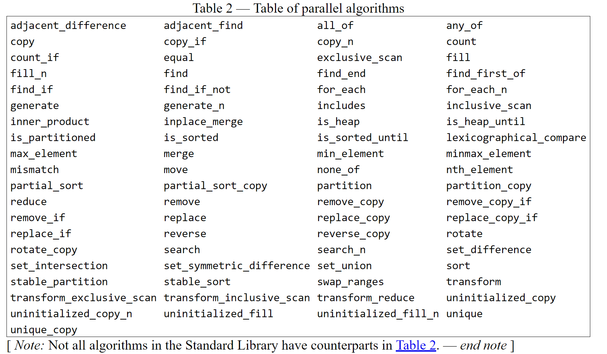

Slide 8
Parallelism TS Algorithms
for_each( std::par, first, last, [](auto x){ process(x); });
// explicitly sequential sort
sort(sequential, v.begin(), v.end());
// permitting parallel execution
sort(par, v.begin(), v.end());
// permitting vectorization as well
sort(par_vec, v.begin(), v.end());

Slide 9
Parallel TS Algorithms
It is the caller's responsibility to ensure correctness, for example that the invocation does not introduce data races or deadlocks.

Slide 10
Parallel TS Algorithms
int a[] = {0,1};
std::vector<int> v;
for_each(par, std::begin(a), std::end(a), [&](int i) { v.push_back(i*2+1); });
Data race!

Slide 11
Parallel TS Algorithms
int x=0; std::mutex m; int a[] = {1,2}; for_each(par, std::begin(a), std::end(a), [&](int) { m.lock(); ++x; m.unlock(); });

Slide 12
Task Block
Task Block proposal
a library function template define_task_block and a library class task_block with member functions run and wait that together enable developers to write expressive and portable fork-join parallel code.

Slide 13
Task Block
template <typename Func> int traverse(node& n, Func && compute) { int left = 0, right = 0; define_task_block( [&](task_block<>& tr) { if (n.left) tr.run([&] { left = traverse(*n.left, compute); }); if (n.right) tr.run([&] { right = traverse(*n.right, compute); }); }); return compute(n) + left + right; }

Slide 14
What’s in C++17
The Parallelism TS, a.k.a. “Parallel STL.”
The Library Fundamentals 1 TS

Slide 15
The Library Fundamentals 1 TS
// Calling a function with a tuple of arguments
template <class F, class Tuple>
constexpr decltype(auto) apply(F&& f, Tuple&& t);

Slide 16
The Library Fundamentals 1 TS
Metaprogramming and type traits (50-100+ броя):
template <class T>
constexpr bool is_lvalue_reference_v = is_lvalue_reference<T>::value;
Compile-time rational arithmetic
template <class R1, class R2>
constexpr bool ratio_not_equal_v = ratio_not_equal<R1, R2>::value;

Slide 17
Optional objects
An optional object for object types is an object that contains the storage for another object and manages the lifetime of this contained object, if any.
The contained object may be initialized after the optional object has been initialized, and may be destroyed before the optional object has been destroyed. The initialization state of the contained object is tracked by the optional object.
A common use case for optional is the return value of a function that may fail. As opposed to other approaches, such as std::pair<T,bool>

Slide 18
optional
optional<char> get_async_input() { if ( !queue.empty() ) return optional<char>(queue.top()); else return optional<char>(); // uninitialized }

Slide 19
any
An object of class any stores an instance of any type that satisfies the constructor requirements or is empty, and this is referred to as the state of the class any object. The stored instance is called the contained object. Two states are equivalent if they are either both empty or if both are not empty and if the contained objects are equivalent.
The non-member any_cast functions provide type-safe access to the contained object.

Slide 20
any
std::any a = 1; std::cout << std::any_cast<int>(a) << '\n'; a = 3.14; std::cout << std::any_cast<double>(a) << '\n'; a = true; std::cout << std::boolalpha << std::any_cast<bool>(a) << '\n';

Slide 21
string_view
The class template basic_string_view describes an object that can refer to a constant contiguous sequence of char-like objects with the first element of the sequence at position zero.
A typical implementation holds only two members: a pointer to constant CharT and a size.

Slide 22
std::search
template<typename Container> bool in_quote(const Container& cont, const std::string& s) { return std::search(cont.begin(), cont.end(), s.begin(), s.end()) != cont.end(); }

Slide 23
std::sample
int main()
{
std::string in = "abcdefgh", out;
std::sample(in.begin(), in.end(), std::back_inserter(out),
5, std::mt19937{std::random_device{}()});
std::cout << "five random letters out of " << in << " : " << out << '\n';
}

Slide 24
What’s in C++17
The Parallelism TS, a.k.a. “Parallel STL.”
The Library Fundamentals 1 TS
The File System TS (based on boost.filesystem )

Slide 25
The File System TS
namespace fs = std::filesystem;
// fail to copy directory fs::create_directory("sandbox/abc"); try { fs::copy_file("sandbox/abc", "sandbox/def"); } catch(fs::filesystem_error& e) { std::cout << "Could not copy sandbox/abc: " << e.what() << '\n'; } fs::remove_all("sandbox");

Slide 26
int main() { std::filesystem::create_directories("sandbox/a/b"); std::ofstream("sandbox/file1.txt"); for (auto& p : std::filesystem::recursive_directory_iterator("sandbox")) std::cout << p << '\n'; std::filesystem::remove_all("sandbox"); } Output:
sandbox\a
sandbox\a\b
sandbox\file1.txt

Slide 27
What’s in C++17
The Parallelism TS, a.k.a. “Parallel STL.”
The Library Fundamentals 1 TS
The File System TS (based on boost.filesystem )
The Mathematical Special Functions IS (based on boost.math )

Slide 28
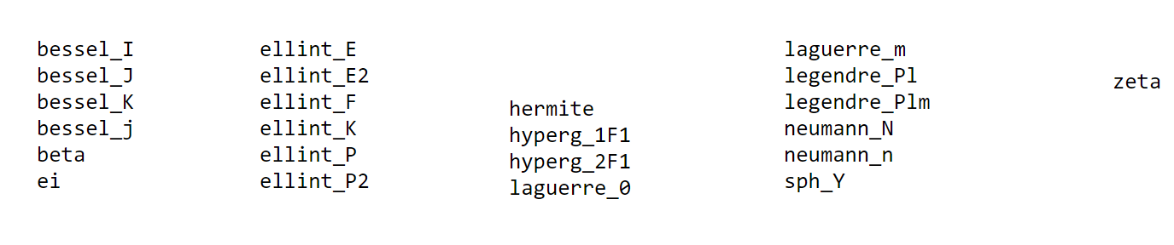
The Mathematical Special Functions

Slide 29
What’s in C++17
The Parallelism TS, a.k.a. “Parallel STL.”
The Library Fundamentals 1 TS
The File System TS (based on boost.filesystem )
The Mathematical Special Functions IS (based on boost.math )
Miscellaneous

Slide 30
Miscellaneous
Lambdas are now allowed inside constexpr functions
Lambdas can now capture a copy of *this object by value, using the notation [*this].
The range-for loop can now deal with generalized ranges where the “end” type is different from the “begin” type
[[fallthrough]], [[nodiscard]], [[maybe_unused]] attributes
Hexadecimal floating-point literals
and more

Slide 31
Range-based for loop
{
auto && __range = range_expression ;
for (auto __begin = begin_expr, __end = end_expr;__begin != __end; ++__begin)
{
range_declaration = *__begin;
Loop_statement
}
}

Slide 32
Range-based for loop
{
auto && __range = range_expression ;
auto __begin = begin_expr ; // __range.begin() or begin(__range)
auto __end = end_expr ; // __range.end() or end(__range)
for ( ; __begin != __end; ++__begin)
{
range_declaration = *__begin;
Loop_statement
}
}

Slide 33
Probably in C++17 during June meeting
if constexpr to allow branches that are evaluated at compile time.
Template parameter deduction for constructors - pair p(2, 3.5); instead of pair<int,double> p(2, 4.5)
Defining the order of expression evaluation
operator. (dot)
Defaulted comparisons, to generate ==, !=, <, <=, >, >= for types that don’t write them by hand.

Slide 34
Bibliography
Parallelism TS
C++ Extensions for Library Fundamentals
File System TS
Special mathematical functions

